Slide 1

Food Access in
By: Kelci Griffin, Anisha Karthikeyan,
Conner Cox, & Jessica Mroczek
Notes:
Conner: Hello everyone, I’m Conner……. Everyone else introduce themselves…….. Conner continues

Slide 2
Overview
Goal: To understand the landscape of food access within Georgia’s 159 counties
Null Hypothesis: Poverty Rate does not affect food access between the counties of Georgia.
Hypothesis: As the poverty rate increases, access to food decreases.
Median Household Income | Average Poverty Rate (%) | Average # of Grocery Stores per County | Avg Population with Low Access to Stores, per County | Change of SNAP-authorized stores 2012-2017 (%) | Average Rate of Diabetes (%)
$42,510 as of 2015 | 2008: 19.12% 2010: 21.72% 2015: 21.91% | 11 | 15,081 | -1.59% | 12.69%
Notes:
Connor
The goal of our data analysis was to understand the landscape of food access amongst the counties of Georgia. We believe that poverty rate affects food access and access to healthy food decreases as the poverty rate increases. To begin our analysis, we identified the 159 unique counties within the state. The average median household income for the state is about 42k people. The poverty rate in 2018 was 19% and increased to about 22% by 2015. There is an average number of 11 grocery stores per county with a mean of 15k people with low access to stores. From 2012 - 2017 the change in SNAP Authorized Stores, decreased by an average of 1.59%. The average rate of diabetes for the state was found to be 12.69%.

Slide 3
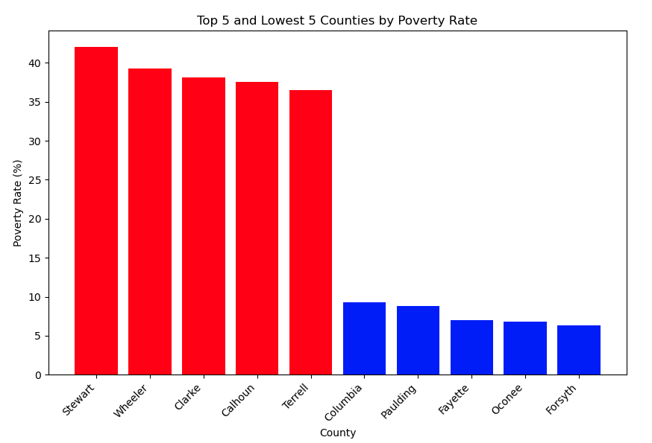
Poverty Rate
Poverty Rate:
Low-income is defined as annual family income of less than or equal to 200 percent of the Federal poverty threshold based on family size.
Notes:
Connor
Within our graph, we have ten counties, each with an associated poverty rate. Counties with higher poverty rates may face greater economic challenges, while those with lower rates may have relatively more economic prosperity. The data is sorted in descending order based on the poverty rate, and the top 5 and lowest 5 counties are selected for visualization. The color of each bar in the chart reflects whether the poverty rate is above 15% (red) or not (blue). This color distinction helps highlight counties with higher poverty rates.

Slide 4
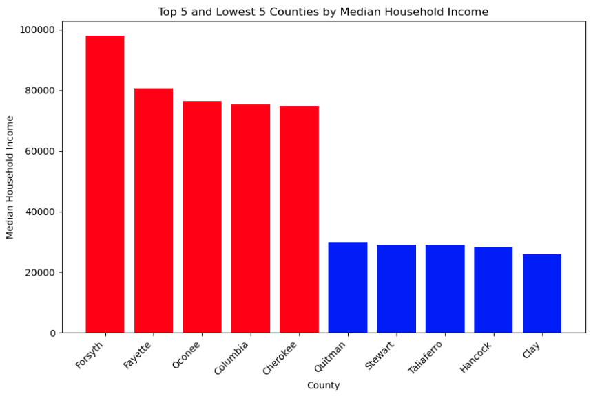
Summary of Median Income
Graph of Median Income:
Median household income state wide: $42,510
SNAP Eligibility: If a household of 2 makes less than $1,526 a month they qualify for SNAP.
Notes:
Connor

Slide 5
How does poverty rate affect access to foods?
Notes:
Connor
So now i’ll go through some information about food access in georgia

Slide 6
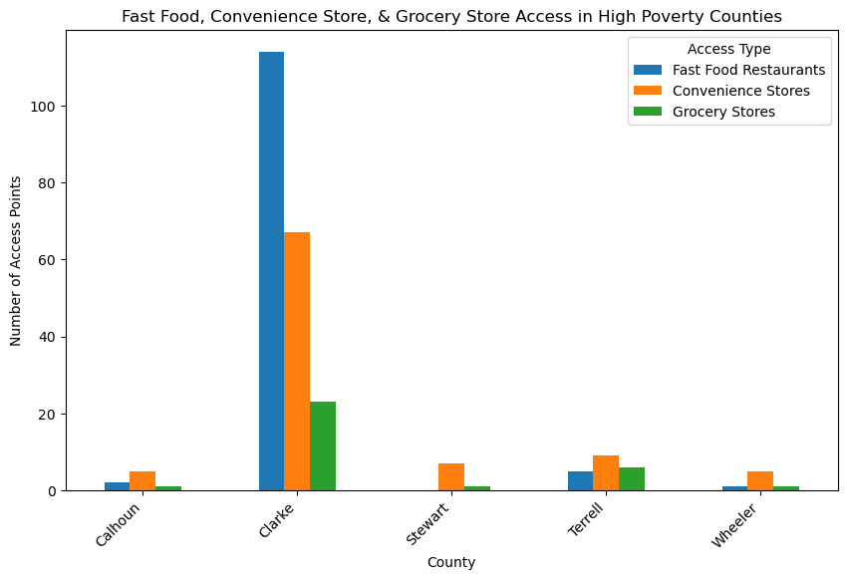
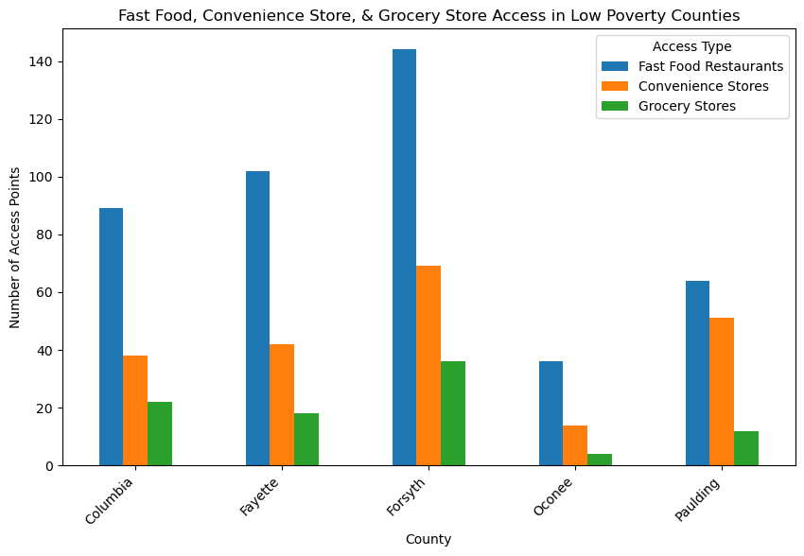
Fast Food, Convenience Store, & Grocery Store Access
Grocery Store:
Stores that reported at least $2 million in annual sales and contained all the major food departments found in a traditional supermarket, including fresh meat and poultry, dairy, dry and packaged foods, and frozen foods
Convenience Store:
Primarily engaged in retailing a limited line of goods that generally includes milk, bread, soda, and snacks.
Fast Food Restaurant
Establishments primarily engaged in providing food services (except snack and nonalcoholic beverage bars) where patrons generally order or select items and pay before eating. Food and drink may be consumed on premises, taken out, or delivered to the customer's location. Some establishments in this industry may provide these food services in combination with alcoholic beverage sales.
Notes:
Kelci- Now that we have a solid overview of the state of Georgia’s median income and poverty demographics, I’d like to explore the landscape of food access in the highest and lowest poverty counties. We will be looking specifically at the number of food access points in each county, because our dataset did not include information on consumer purchasing behavior. This means, we can see what residents of each county had available, but we can not see trends on what they bought. Food access was broken down into 3 main categories, which are grocery stores, convenience stores, and fast food restaurants. To create our samples, data was pulled on the 5 counties with the highest poverty rate and the 5 counties with the lowest poverty rate. The USDA website defines each of the 3 categories as follows: Grocery stores (green) are classified as establishments that report at least $2 million annual revenue, and stock fresh meat, poultry, and dairy, dry and packaged foods, and frozen foods. Convenience stores (orange) primarily sell a more limited line of goods that include milk, bread, snacks, and soda. Fast food restaurants (blue) primarily provide food services where patrons generally pay before eating, and options are more limited. Food may be consumed on premises, taken out, or delivered to the customer.
Now that we understand how the USDA defines our access point variables, we can make more sense out of the visualizations. As previously stated, we’re focusing today on access points (as availability) vs access itself. We can see that in the lowest poverty rate counties, and in Clark County (one of the highest poverty counties), fast food establishments vastly outnumber grocery stores and convenience stores. The next most prevalent access point type are convenience stores– and we can see that the trend is consistent between the highest and lowest poverty counties. Convenience stores outnumber grocery stores in each county we sampled, no matter the poverty rate. Grocery stores have the lowest numbers in both visualizations, with Forsyth county at 36 and Stewart, Wheeler, and Calhoun each having just one (well below the average number of 11). This is a clear illustration of the disparity in food access points across Georgia’s counties.
Even in the most affluent counties of Georgia, grocery stores are far outnumbered by other types of access points. Based off this data alone, we can’t say what’s the most popular, but we can see what might be the easiest to access, and at the very least the most common food establishment– fast food.

Slide 7
How has this trend changed over time?
Notes:
Anisha

Slide 8
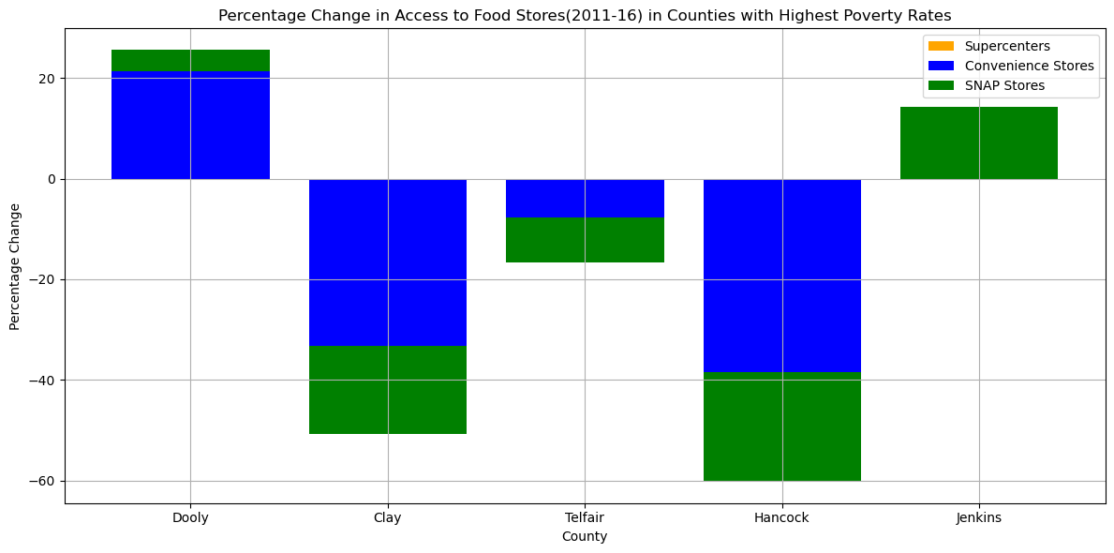
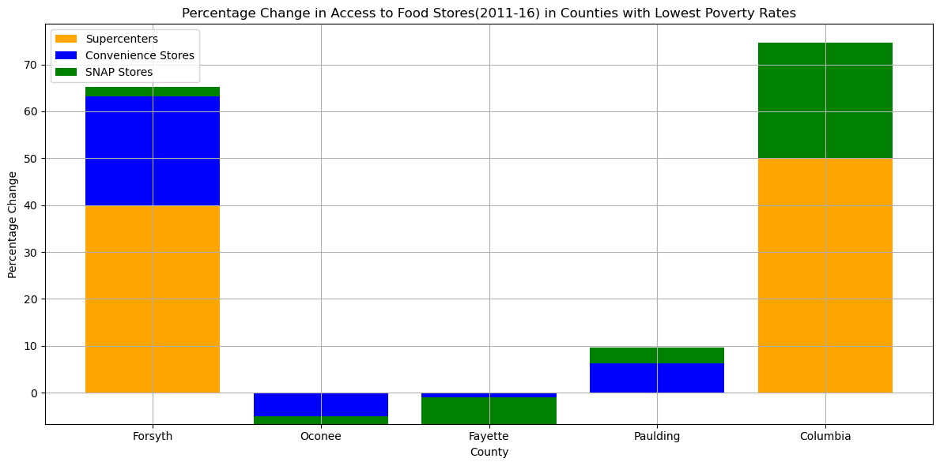
Percent Change in Access to Food Stores by Store Type in Counties with Low vs. High Poverty Rates
Notes:
**Percent Change in Number of Food Stores in Georgia's Top 5 High-Poverty Counties**
In the first figure, our focus is on the percent change in the number of food stores—convenience stores, SNAP-eligible stores, and supercenters—across the five counties in Georgia with the highest poverty rates. The trends observed reveal a challenging scenario in these economically distressed areas. A prevalent theme is the dominance of negative percent changes, indicating a lack of growth or development in the number of food stores. This suggests considerable obstacles in expanding access to food resources within counties grappling with high poverty rates.
One notable observation is the absence of discernible evidence supporting the growth of supercenters in these high-poverty counties. Despite both supercenters and SNAP stores being recognized as crucial for assisting low-income individuals and families to alleviate food insecurity, the lack of supercenter growth prompts further questions about the accessibility of these resources in areas facing economic hardships. In instances where there is evidence of development in the graph, it is primarily in the form of an increase in the number of SNAP-eligible stores, underscoring the vital role of SNAP programs in addressing food insecurity in high-poverty areas.
**Percent Change in Number of Food Stores in Georgia's Top 5 Low-Poverty Counties**
Shifting our attention to the second graph, which portrays the percent change in the number of food stores in the five counties in Georgia with the lowest poverty rates, a more positive narrative unfolds. Counties with lower poverty rates generally exhibit positive percent changes, indicating development in the number of food stores. This suggests a more favorable environment for expanding access to food resources in economically stable areas.
Of particular note in this graph is the evidence of supercenter growth, a contrast to the findings for the counties with high poverty rates. The presence of supercenters in economically stable areas is a positive indicator, as these establishments offer lower prices and a broader variety of products, potentially contributing to improved access to affordable and diverse food options.
However, the trends for SNAP-eligible and convenience stores in low-poverty rate areas are mixed. While the overall percent change is positive, indicating development, two out of the five counties show evidence of negative percent change in the number of SNAP-eligible stores and convenience stores. It is crucial to acknowledge that negative percent change in these store types may not necessarily imply a lack of access to food, and further investigation is warranted to understand the underlying dynamics.
In conclusion, the comparison between Graphs A and B underscores the disparities in access to food stores based on poverty rates. It emphasizes the need for targeted interventions to address food insecurity in economically distressed areas, where challenges in growth and development of food stores are more pronounced.

Slide 9
Who is affected?
Notes:
Anisha
Moving on to the next slide, we aim to answer the question: Who is affected by these disparities in food access? Let's explore the demographics of the population facing low access to stores.

Slide 10
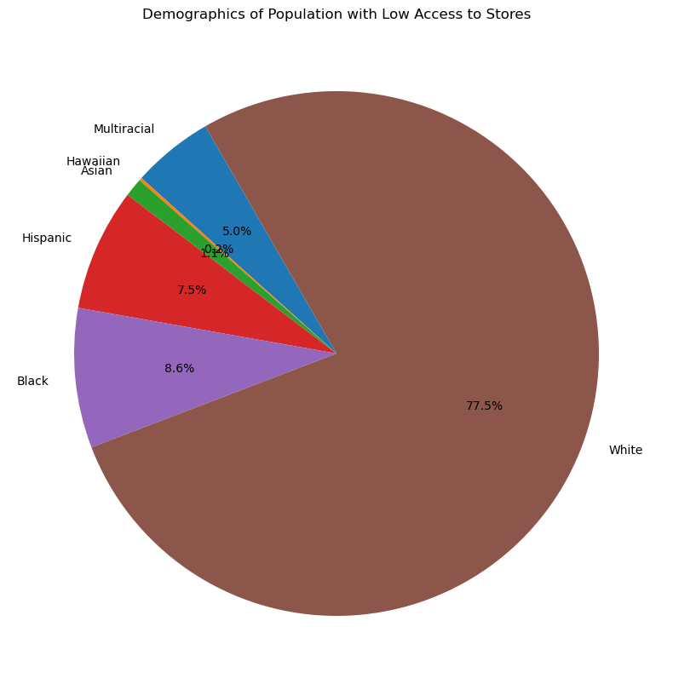
Low Access to Stores:
number of people in a county living more than 1 mile from a supermarket or large grocery store if in an urban area
more than 10 miles from a supermarket or large grocery store if in a rural area.
Notes:
Here we explore some insights from our dataset on the demographics of individuals facing low access to stores. In this pie chart, we've examined the composition of this population, defined as those living more than 1 mile from a supermarket in urban areas or more than 10 miles in rural areas.
The chart reveals that the majority, 77.5%, of individuals facing these access challenges are from the White demographic. Understanding this racial composition is pivotal for tailoring interventions and support programs to meet the specific needs of this group.
Conversely, the Black community represents 8.6% of the population with low access to stores, highlighting disparities within communities. Addressing the needs of this group is crucial for promoting equitable access to essential resources.
Additionally, when considering the Hispanic, multiracial, Asian, and Hawaiian Pacific Islander communities together, they make up 15.8% of the population facing limited access to stores. Within this combined group, the Hispanic community constitutes 7.5%, while multiracial, Asian, and Hawaiian Pacific Islander groups make up the remaining percentage. This underscores the diverse challenges faced by different ethnic groups in accessing essential food resources.
Our analysis emphasizes the need for nuanced and targeted approaches to address disparities in access. Recognizing the specific challenges faced by different racial and ethnic groups is crucial for developing effective strategies to enhance access to essential resources and promote equitable outcomes.

Slide 11
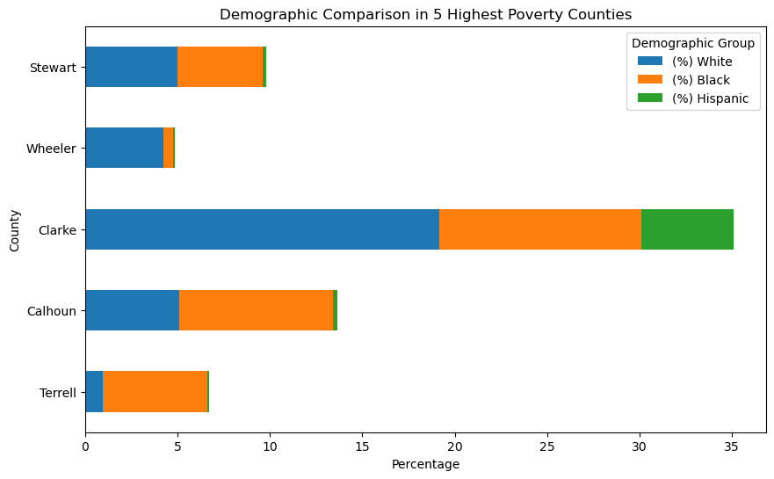
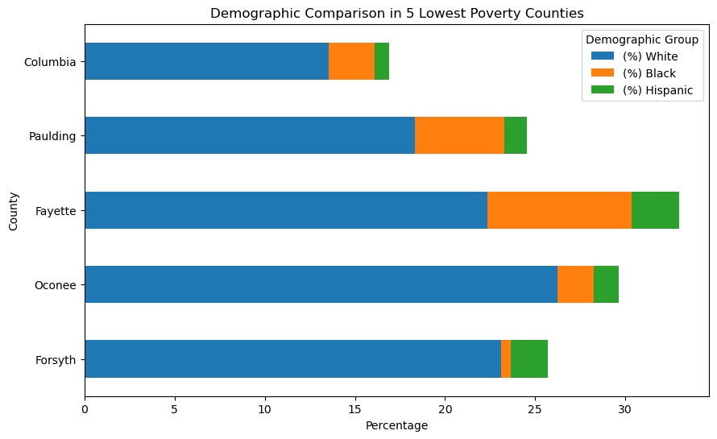
Low Access Demographics by County
Notes:
Anisha

Slide 12
How does poverty & income affect diabetes rates?

Slide 13
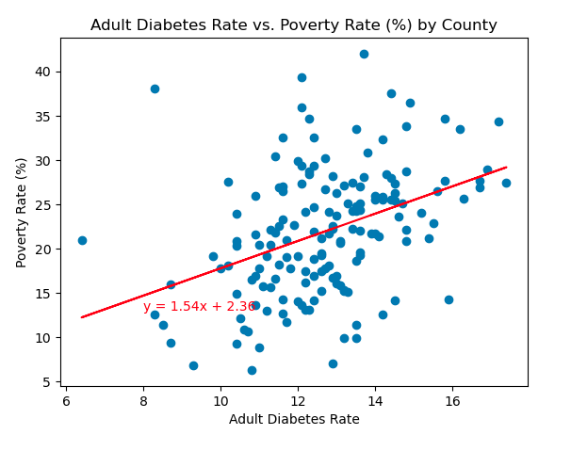
The r-squared is: 0.15757508043092436
Notes:
To identify if health outcomes are affected by poverty rate, we looked at the rate of diabetes within each county. Diabetes is a chronic disease that affects the pancreas’s ability to produce the hormone insulin. Insulin helps regulate the glucose level in the blood. The risk factors for developing type 2 diabetes are family history of diabetes, obesity, a sedentary lifestyle, poor diet, and certain ethnicities are all associated with a higher risk of developing type 2. We utilized a scatter plot to chart all counties using the poverty rate and the adult diabetes rate. The diabetes rate average for the state of Georgia about 12%. The linear regression trend line indicates a weak correlation between these two variables that as poverty rate increases, adult diabetes rates tend to increase. However, due to the r-squared value being under .3, we can not determine if these variables are correlated.

Slide 14
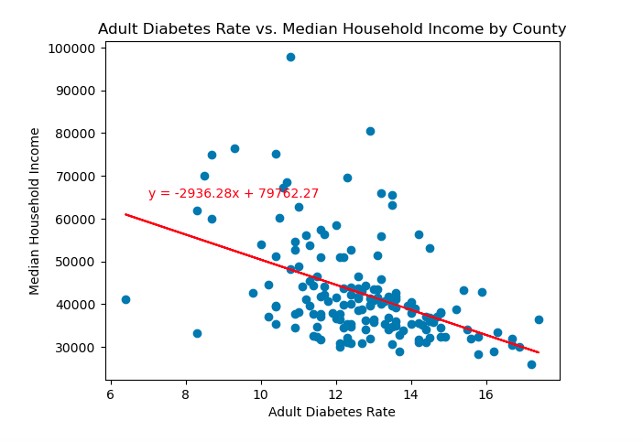
The r-squared is: 0.21364584459397454
Notes:
Jess: We then compared the diabetes rate to median household income for all counties to see if there was a weak correlation between these two factors. Median Household income was defined by the USDA Food Access Atlas was based on the distribution of family income, which also included families with no income. As a reminder, the median household income for the state of Georgia is around 42K and as you can see is where a majority of the counties fall within the graph. In our analysis we found an R-squared value of .21 which indicates a very weak correlation between the two variables. Although these two variables do not have a strong correlation, in future analysis, we believe that data showing diabetes rates over time by county would support the theory of access to healthy foods can be affected by the financial demographics of a counties population.

Slide 15
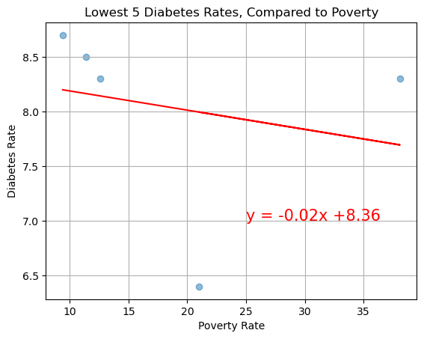
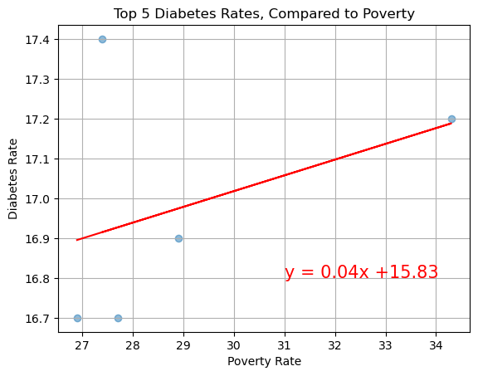
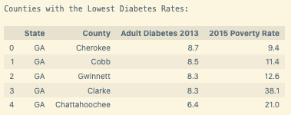
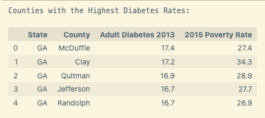
The r-value is: 0.04963428611368652
The r-value is: 0.1482573078286788
Notes:
We then assessed the poverty rates of counties with the lowest rate of diabetes and the highest rates of diabetes. The images on the left outline the counties with the lowest rates of diabetes and their poverty rate in 2015. There was no correlation between these variables, however, the linear regression of this data does show a negative regression trend. Similarly, the illustrations on the right show the counties with the highest rates of diabetes. The r squared value of .14 tells us that there is either no or a very weak correlation between the two variables.

Slide 16
Conclusion:
Based on the data we recovered, we were able reject the null hypothesis. Our data shows that as poverty rates increase, access to healthy food decreases. Additionally, it appears that as poverty rates increase, diabetes rates also increase. That being said, although the visualizations display clear trends in the relationship of health and income, the statistical significance of that data was too weak to determine correlation.
Clarke County is a potential outlier in our data, because although it is among the highest poverty rate counties in Georgia, the population has similar food access to counties with the lowest poverty rates. It also boasts one of the lowest diabetes rates in the state.
Potential limitations in our dataset include a lack of comprehensive poverty rates, limited health information, and no data to represent actual consumer purchasing trends.
Notes:
With more information, we do believe we could further prove our hypothesis that income negatively affects food access, and show that low income and low food access together influence negative health outcomes like diabetes.
This makes sense, because it is a college town, with ~40k students providing an economic boost. Although students are considered temporary residents, the population influx and money that comes with, are able to drive infrastructure to a level comparable to counties where the census reports higher median incomes.

